Slide 1
Simulating Observation Error in Dirichlet-Multinomial Composition Samples
Jon Brodziak
Jon.Brodziak@noaa.gov

Slide 2
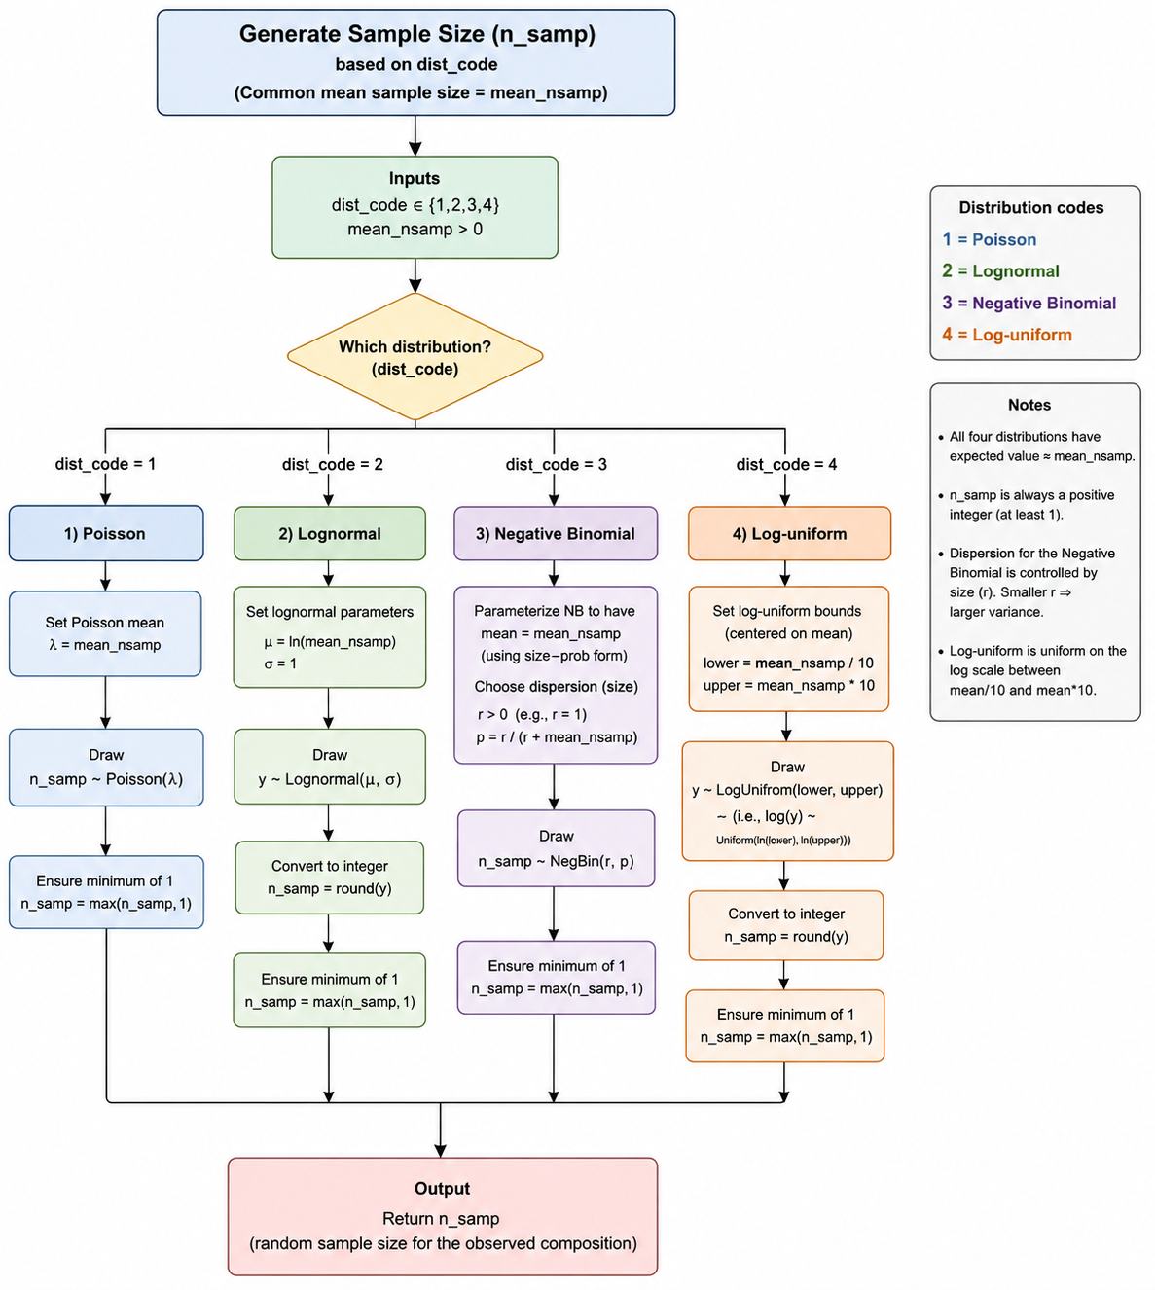
Randomly Generate Sample Sizes for Observed Composition Data

Slide 3
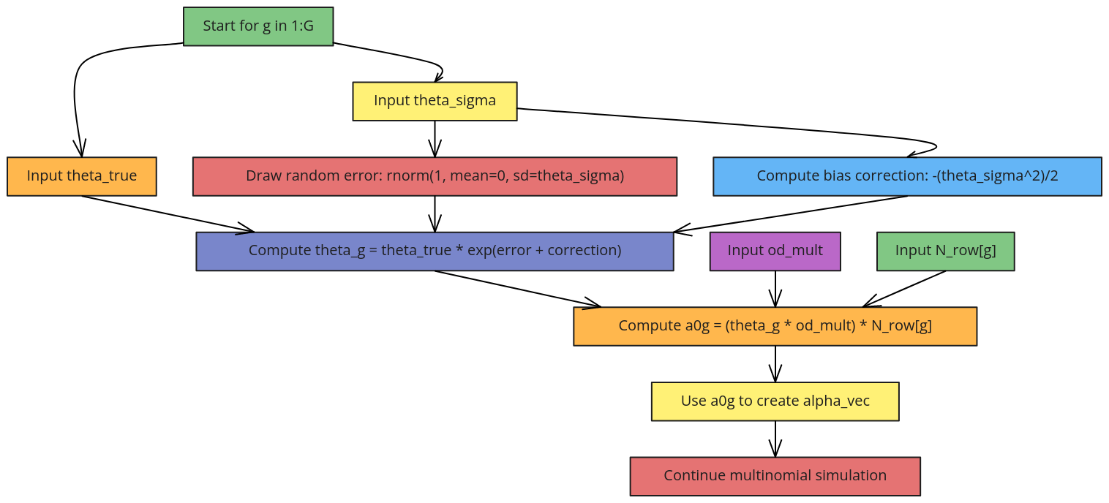
Generate DM Total Concentration

Slide 4
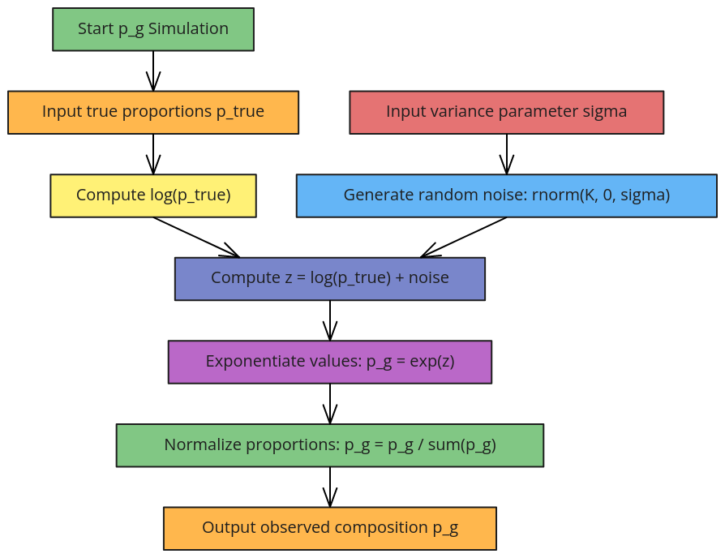
Generate Observed Proportion

Slide 5
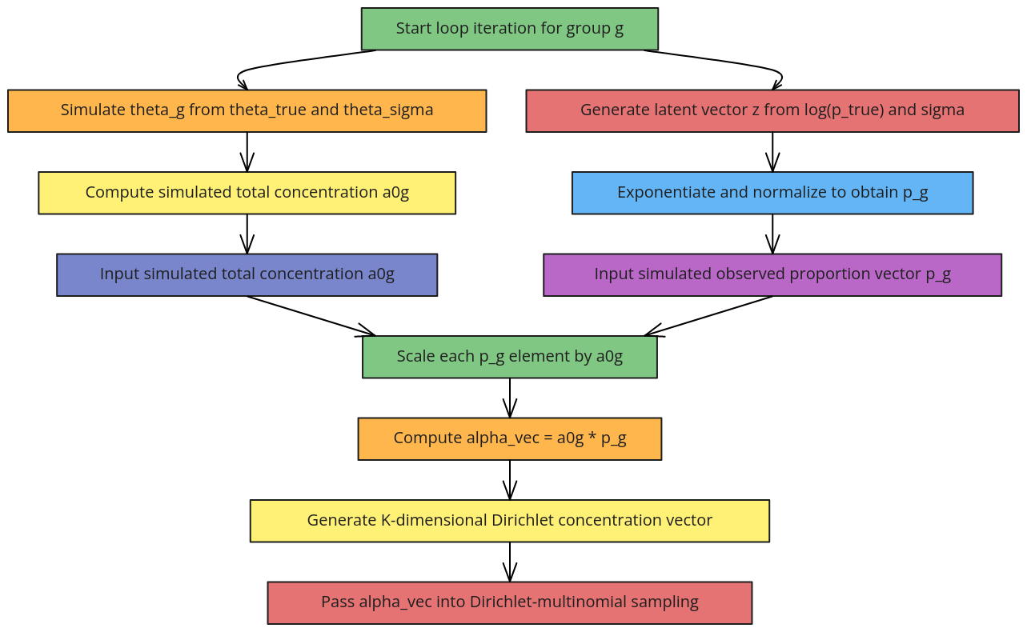
Generate DM Concentration Vector

Slide 6
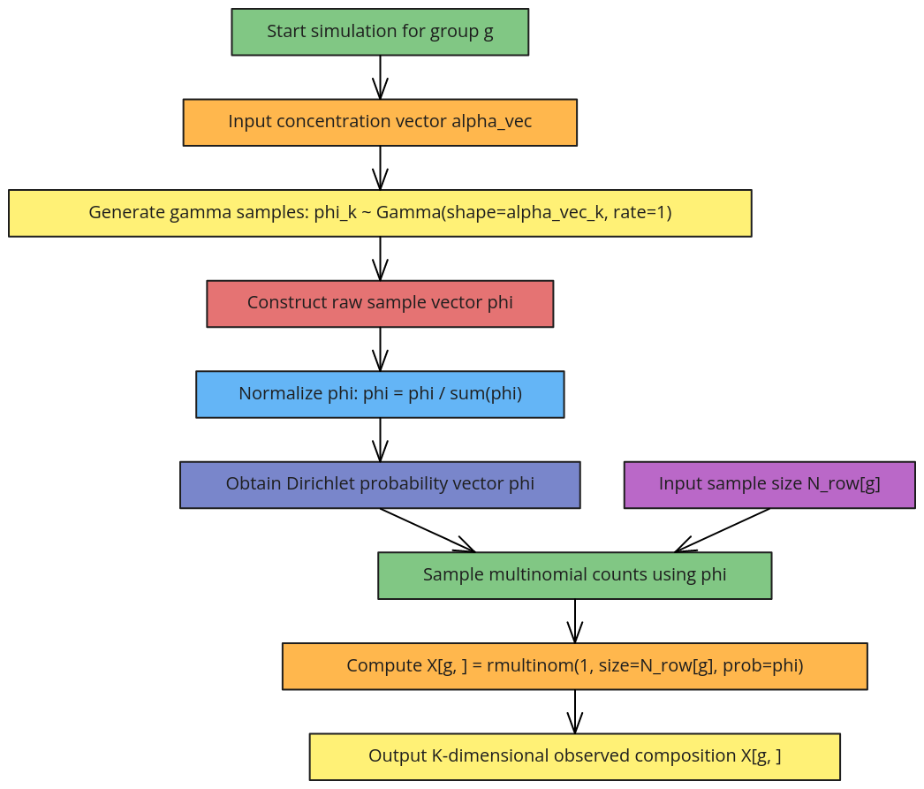
Generate Observed Composition Data

